Slide 1
Project 1: The Effect of State Merit Aid on Choice of College Major
By Poornima Joshi & Tyler Remick

Slide 2
State Merit Aid Programs
Scholarship awards for High School graduates to in-state colleges and universities if they satisfy GPA threshold
Primary motivation of such programs is to increase college attainment and education level of state labor force
The literature has focused on the effect of state-merit on enrollment, persistence, completion, long-term outcomes, and post-college retention

Slide 3
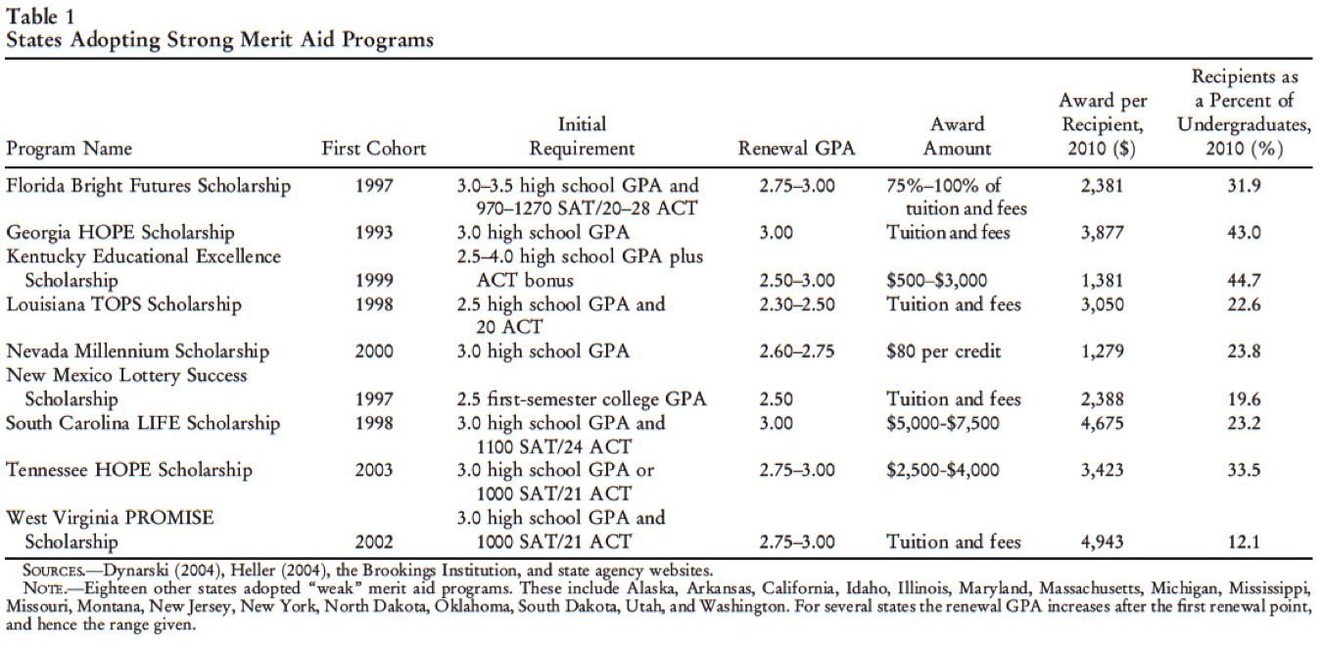
State Merit-Based Scholarship Programs

Slide 4
Research Question
Question:
How do State Scholarship programs effect a student’s choice of major?
Why is this important?
A college education has a significant influence on one’s lifetime earnings – earnings generate tax revenues.
The demand for each major is not constant across time, or region. It is important to understand if students are choosing majors that are inconsistent with the demands of the state labor market. This may result in one of three outcomes:
Employers being forced to hire students with inadequate skills and training
Students with inadequate skills and training are not hired in the state
These students either become unemployed, or seek employment in another state/region that demands their skill set

Slide 5
Theoretical Framework & Hypothesis
Theoretical Framework:
Three reasons why State Scholarships will induce students to substitute away from STEM majors:
1) Annual renewal requirements
Students must maintain a minimum GPA in order to renew scholarship each year – this will induce students to enroll in majors that are less rigorous
2) Income effects
State merit aid is an in-kind transfer of income. As a result, students will consume more normal goods, and less inferior goods
3) Substitution effects
State merit aid changes the relative return across majors. As a result, majors that offer lower earnings potential become relatively more attractive pursuit
Hypothesis:
Three channels through which state scholarships will induce students to enroll in non-STEM majors:
1) STEM curriculum is more rigorous than non-STEM curriculum – annual renewal requirements will induce students to enroll in non-STEM majors.
2) STEM majors are inferior goods, meaning, on average students enroll in STEM when income is lower. State merit aid is an in-kind transfer of income, students become wealthier and therefore enroll in more non-STEM
3) STEM majors have greater earnings over lifetime compared to non-STEM. The returns to non-STEM majors increases as a result of state merit aid, so students will substitute away from STEM Majors

Slide 6
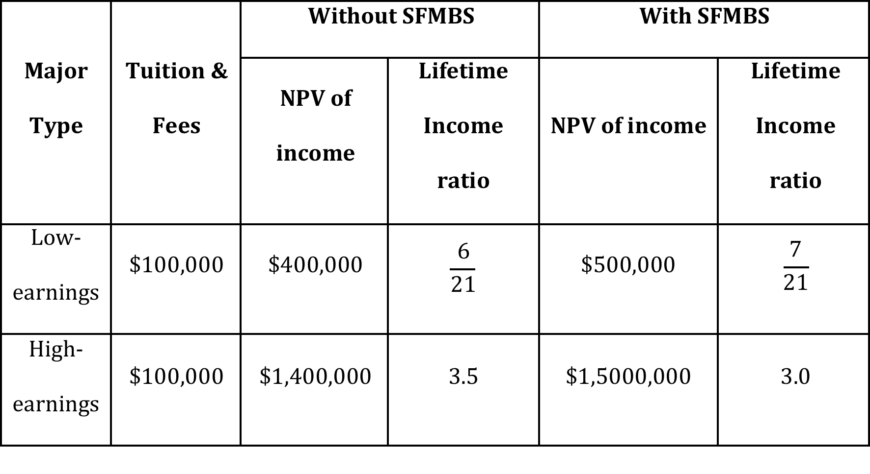
Quick Illustration of Substitution Effect

Slide 7
Estimation Methodology
Linear probability model:
P(Y_{isct} = 1) = Γ_{s} + π_{c} + βX_{isct} + δ_{s}T_{sc} + θMerit_{sc} + ε_{isct}
Y equals one if individual i, from state s, born in cohort c, in survey year t, completed a bachelor’s degree in a STEM field
Γ_{s} is a state-of-birth fixed effect
π_{c} is a birth cohort fixed effect
X_{isct} includes a set of dummy variables for age, Hispanic origin, race and sex
T_{sc} is a state-of-birth by year-of-birth time trend
Merit_{sc} is an indicator equal to one if the respondent was exposed to a state merit program
The parameter of interest is θ and the inclusion of the state-of-birth and year-of-birth fixed effects allow θ to be interpreted as a Difference-in-Differences estimate.

Slide 8
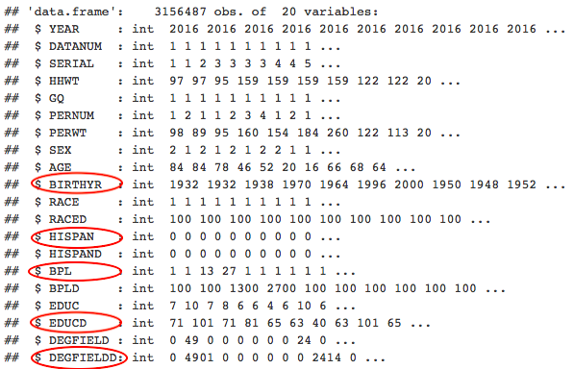
Exploratory Data Analysis
Notes:
We got the dat a from ***** source. It consisted of 3156487 rows and 20 columns. We were mainly interested in these variables. We transformed the sex, race and hispan variable to factor level variables and filtered the degree fields to extract the stem fields to outstem. We also filtered out students by birth place and year of birth so we can see only the students that were exposed to the funding. Cleaned up the data to see if the students belonged to a specific race or not and finally converted everything to categorical/dummy variables. In the last step, we dropped everything we do not need and run the final data against a linear regression model to see the following results.

Slide 9
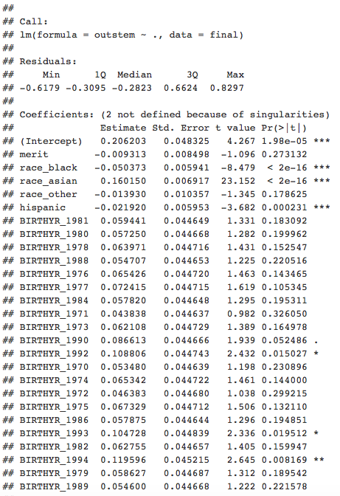
Results

Slide 10
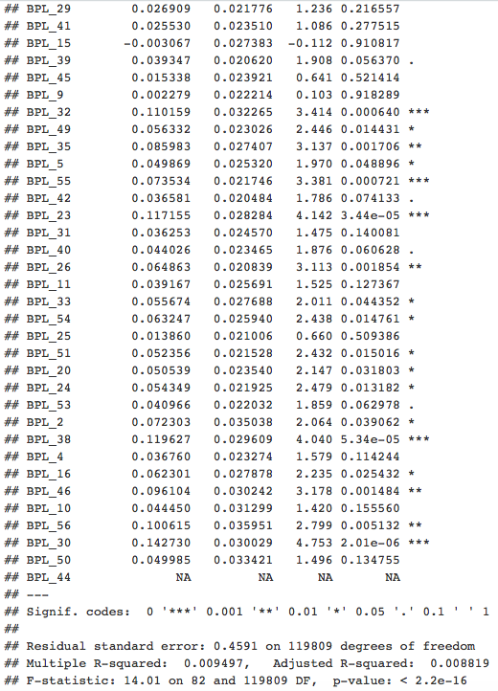
Results

Slide 11
Concerns & Further Research
Concerns:
Omitted variable: high school rigor influences data generation process
Omitted variable: international student enrollment
Further Research:
How does choice of major effect labor market outcomes?
Does increased sorting as a result of SFMBS increase intra-regional employment in SFMBS states?

